Slide 1
Line Launcher
Presentation
23 April 2020

Slide 2
Presented By Group 5 ME-11 C SMME, NUST, ISLAMABAD, PAKISTAN
Hassaan Ahmad (284811)
Rana Sohaib Ullah (286694)
Abu Huraira (284624)
Huzaifa Irfan (285501)
Hassan Ahmad (289686)

Slide 3
Disclaimer
The Design for this project is final so far. Due to CoVid-19 Lockdown, It may be changed during fabrication after the reopening of Universities and Markets.

Slide 4
Contents
1. Structure Analysis 2. Working Principle 3. Materials Selection 4. Expected Cost 5. Fabrication Process 6. Expected Shortcomings

Slide 5
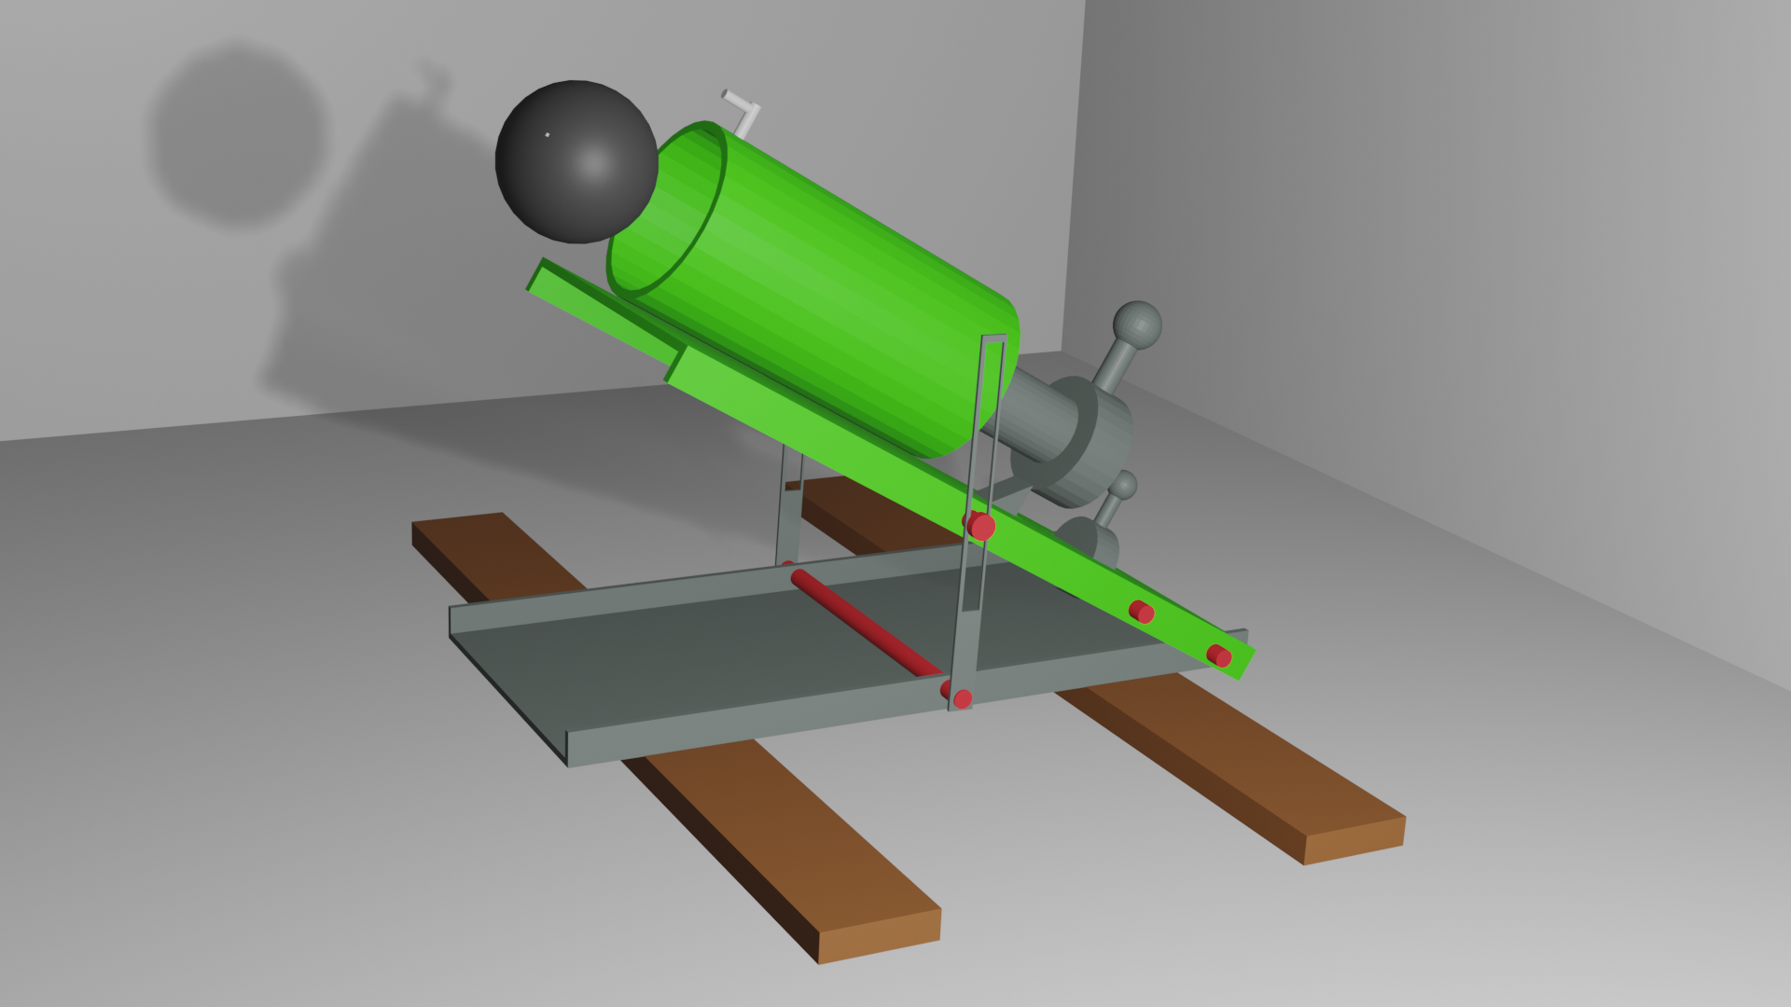
Design

Slide 6

Structure Analysis

Slide 7
1
Base plate
2
Moveable Plate
3
Pipe
4
Striking Rod
5
Trigger
6
Link

Slide 8

The base plate is made of the plastic on which moveable plate is connected. The base plate is bearing all weight and is supporting moveable plate over it.
The Base Plate
And
The Moveable plate
The moveable plate is also made of the plastic and is supporting the pipe in which the ball is placed. It can move with the help of link which is connected with the base plate and moveable plate.

Slide 9

The Pipe And The striking rod
Both of the materials are made of the plastic. The rod is put inside the pipe along the spring on it. When the rod is pulled back the spring get compressed and the energy is stored inside it. The rod is locked at its pulled position by locking it to the trigger.

Slide 10

The trigger and the link
The trigger is made of the plastic. It is connected with the moveable plate and its one end is present at the empty slot present in the center of the moveable plate which serves as the lock. While the other end is act as trigger.
The link is also made of the plastic. It is the connection between the base plate and the moveable plate. It serves as the angle changer between the two plates due to which the angle of projection also changes.

Slide 11
The working principle of the linear launcher depends upon the law of conservation of energy in which first energy is stored in the form of elastic potential energy inside the spring and then this energy is released to attain certain kinetic energy.
Working Principle

Slide 12

Working principle
When the striking rod is pulled back the spring over it got compressed and then it stores the elastic potential energy in it. The rod can be locked with the trigger. So when the small external force is applied on the trigger the rod got unlocked and it launches the ball by changing the potential energy into the kinetic energy and the ball hits the certain target according to the calculation. We can change the angle of projection with the help of the link present between the plates.
g

Slide 13




Material selection is the basic and most important step for the making or formation of any kind of device.
Materials Selection
For material selection it must be kept in mind that the selected material must be reliable, cheap and effective.
The cheap material will help in more production of the device and is easily available.
For the “line launcher” project our group also selected material that is efficient in working it is and also very cheap.

Slide 14
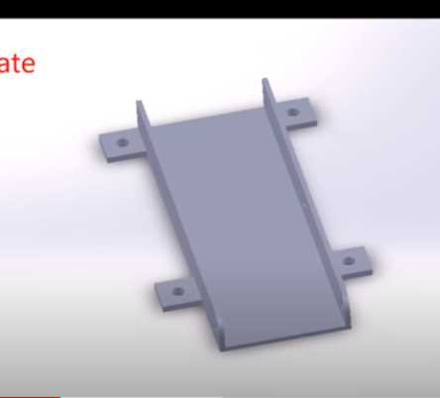
Selected materials
Base plate:
The base plate is made up of hard steel sheet which is curved from the sides to support the movable plate and also to support the launching assembly.

Slide 15
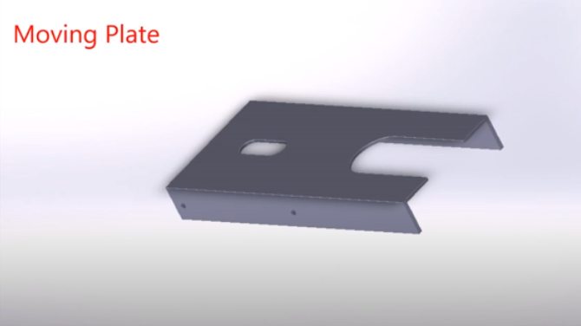
Moving plate:
Moving plate will be fixed on base plate. It is also made up of steel..

Slide 16
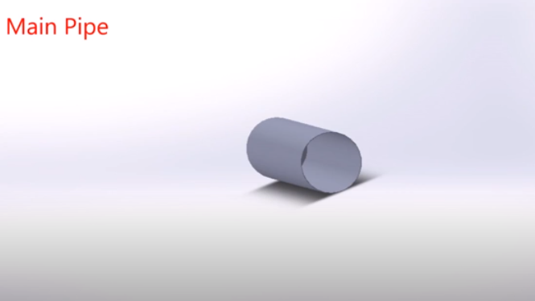
Main pipe:
A pipe is used for the projection of ball. The material of pipe is hard
steel of hard plastic depending on the material which is easily available. .

Slide 17
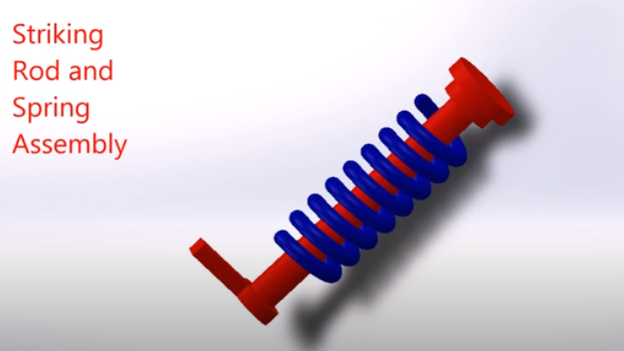
Striking rod and spring assembly:
Force is applied with the help of striking rod and spring help in
application of force.

Slide 18
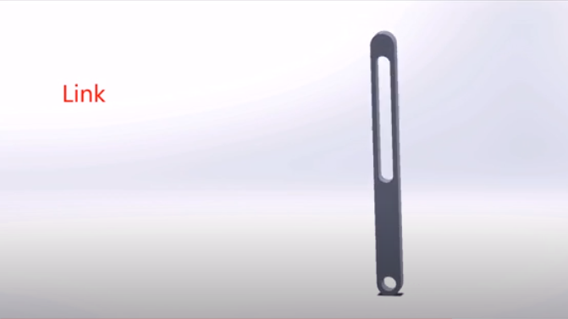
Link:
Link is also present for support made up of hard plastic or steel.

Slide 19
Cost Analysis
Sr NO.# | Description | Price
1 | Metal Sheet x2 | 75*2=150
2 | A Pipe | 30
3 | Striking rod & Spring Assembly | 70
4 | Link | 70
5 | Electric Switch | 50
 | Total | 370

Slide 20
Fabrication process starts with the joining of base plate with movable plate.
The joining will be completed by the help of bolts.
FABRICATION PROCESS
This will be followed by the joining of main pipe with the movable plate.
The spring assembly and striking rod will be inserted in the main pipe.
Then the link will be connected with main pipe and movable assembly to control the projection process.
Then an electronic switch will be inserted to control link used for projection.

Slide 21
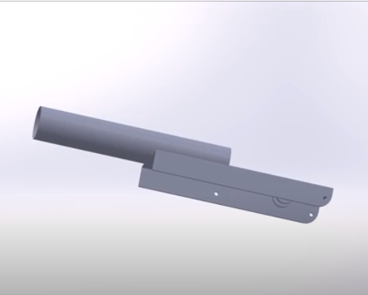
STEPS OF FABRICATION:
Step 1:
Joining of main pipe and movable plate:

Slide 22
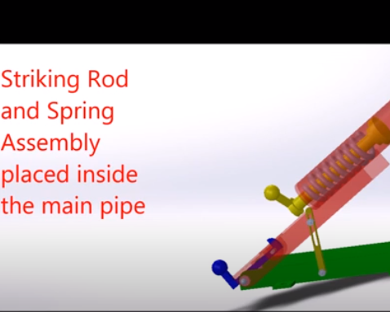
Step 2:
Striking rod and spring assembly placed inside the main pipe:

Slide 23
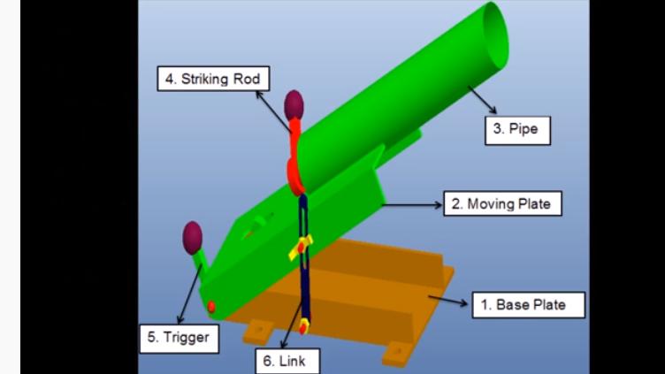
Step 3:
Link and electronic switch inserted in the device to complete fabrication.

Slide 24
Every engineering device must have some shortcomings.
Related to linear launcher project we will do over best to reduce the shortcomings.
EXPECTED SHORTCOMINGS IN DEVICE:
But that is not possible that all the shortcomings will removed.
But it is possible that their number will be reduced.
So as a student of mechanical engineering it is our duty to reduce the shortcomings.
Here is the list of some expected shortcomings that we will face when we will fabricate our project after the reopen of university.

Slide 25
1. Angle measurement:
Angle measurement is a defect of our expected device that we will make because will not designing any particular instrument for measurement. We will measure angle with the help of protector without any special instrument attached with device. So our angle may have an uncertainty of almost 2%.
So this will be the first expected shortcoming of our expected device.
But we will try to reduce the uncertainty in angle by taking an average reading of angle.

Slide 26
Rotation of movable plate along only one axis:
The movable plate which is on the base plate is only movable along x-axis.
The movable plate is restricted to move along y-axis and also along z-axis.
This is an other expected shortcoming of our expected device.
The design of our device will allow movement along only one axis.
Friction in the pipe and air resistance:
This is the natural shortcoming of every mechanical device. We will not overcome air resistance but friction in the pipe can be overcome by the help of lubrication but will not be erased completely.

Slide 27
Thank You

